Slide 1
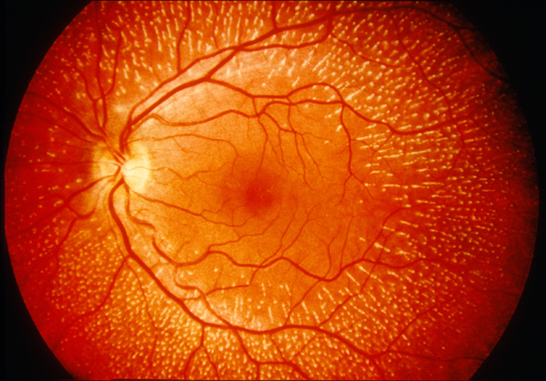
Batten Disease
CLN3 Gene
Elizabeth Zanetakos

Slide 2
What is Batten Disease?
Severe neurodegenerative disorder that has a juvenile onset

Slide 3
What are the symptoms of Batten Disease?
7-10 years old
4-7 years old
7-10 years old
7-10 years old
10 - 12 years old

Slide 4
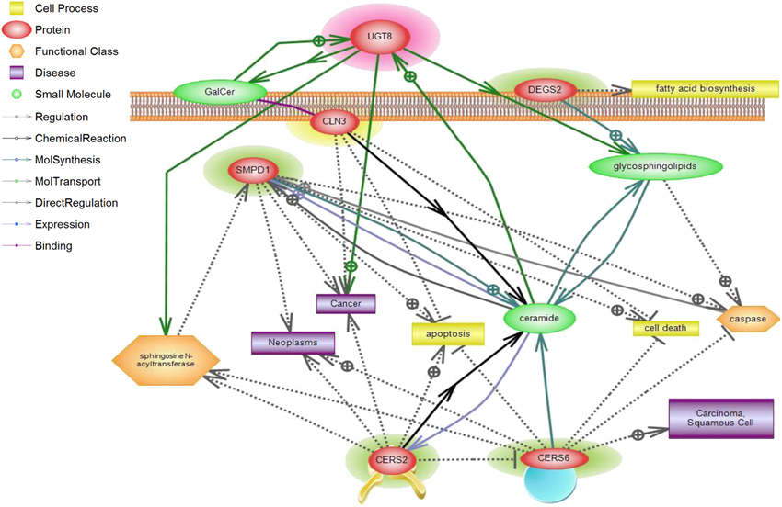
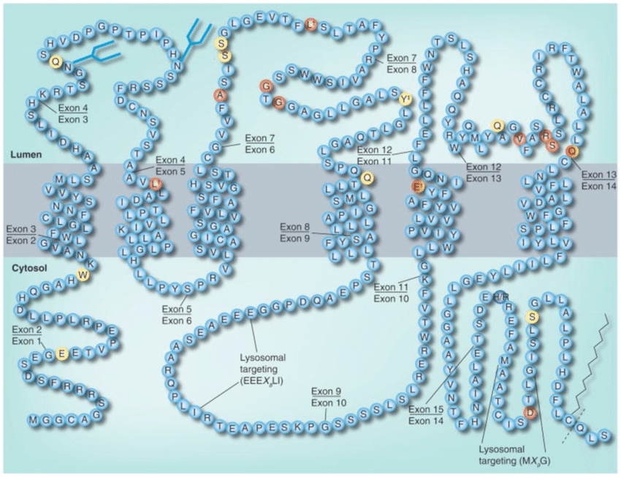
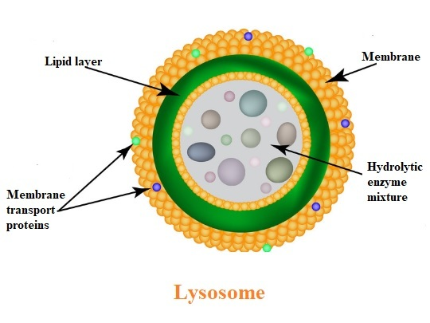
What gene is associated with Batten Disease?
438 aa
Biological Process
Molecular Function
Cellular Component

Slide 5
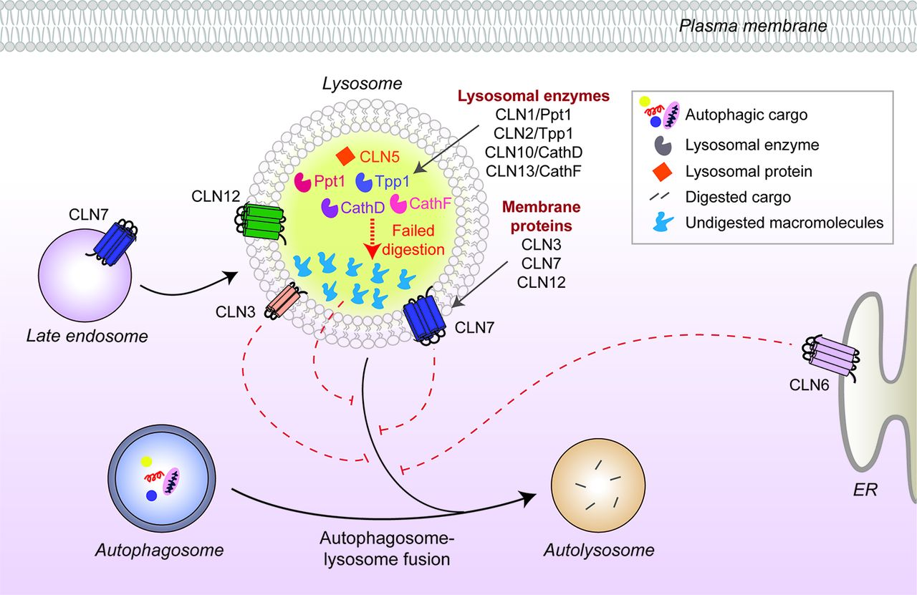
Where can battenins be found?

Slide 6
What are the gaps in knowledge?

Slide 7
How conserved are CLN3 homologs?
% Identity
Length
438 aa
434 aa
422 aa
325 aa
422 aa
438 aa
438 aa
435 aa
446 aa

Slide 8
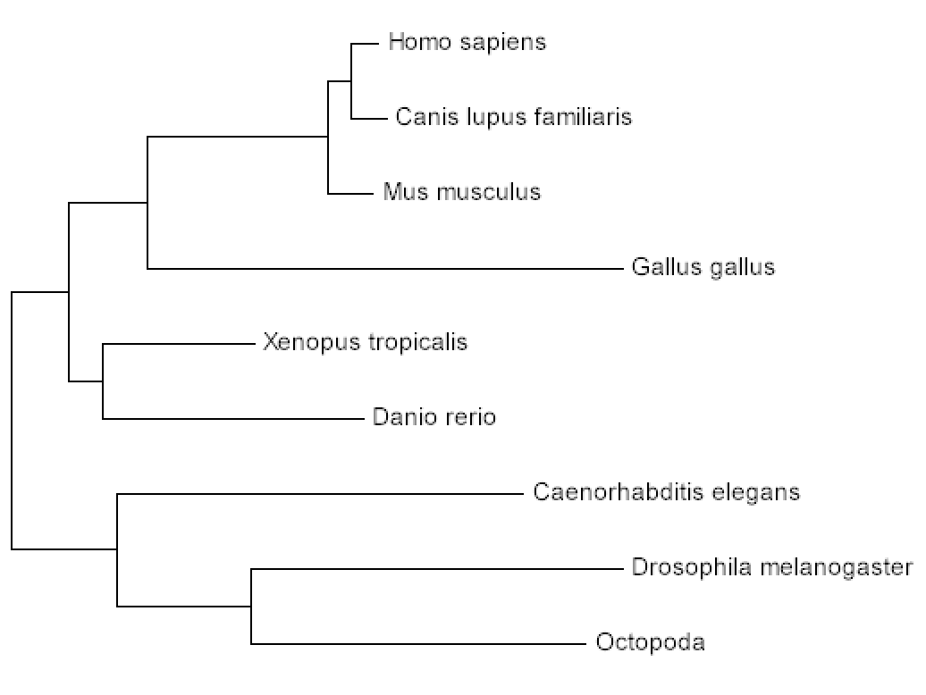
How are CLN3 homologs related?

Slide 9
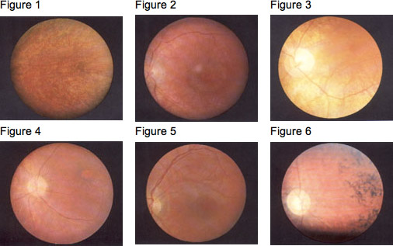
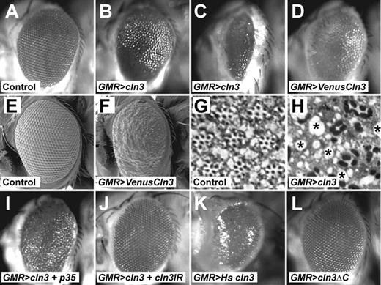
Why use a fruit fly as the model organism?
Human
Fruit Fly

Slide 10
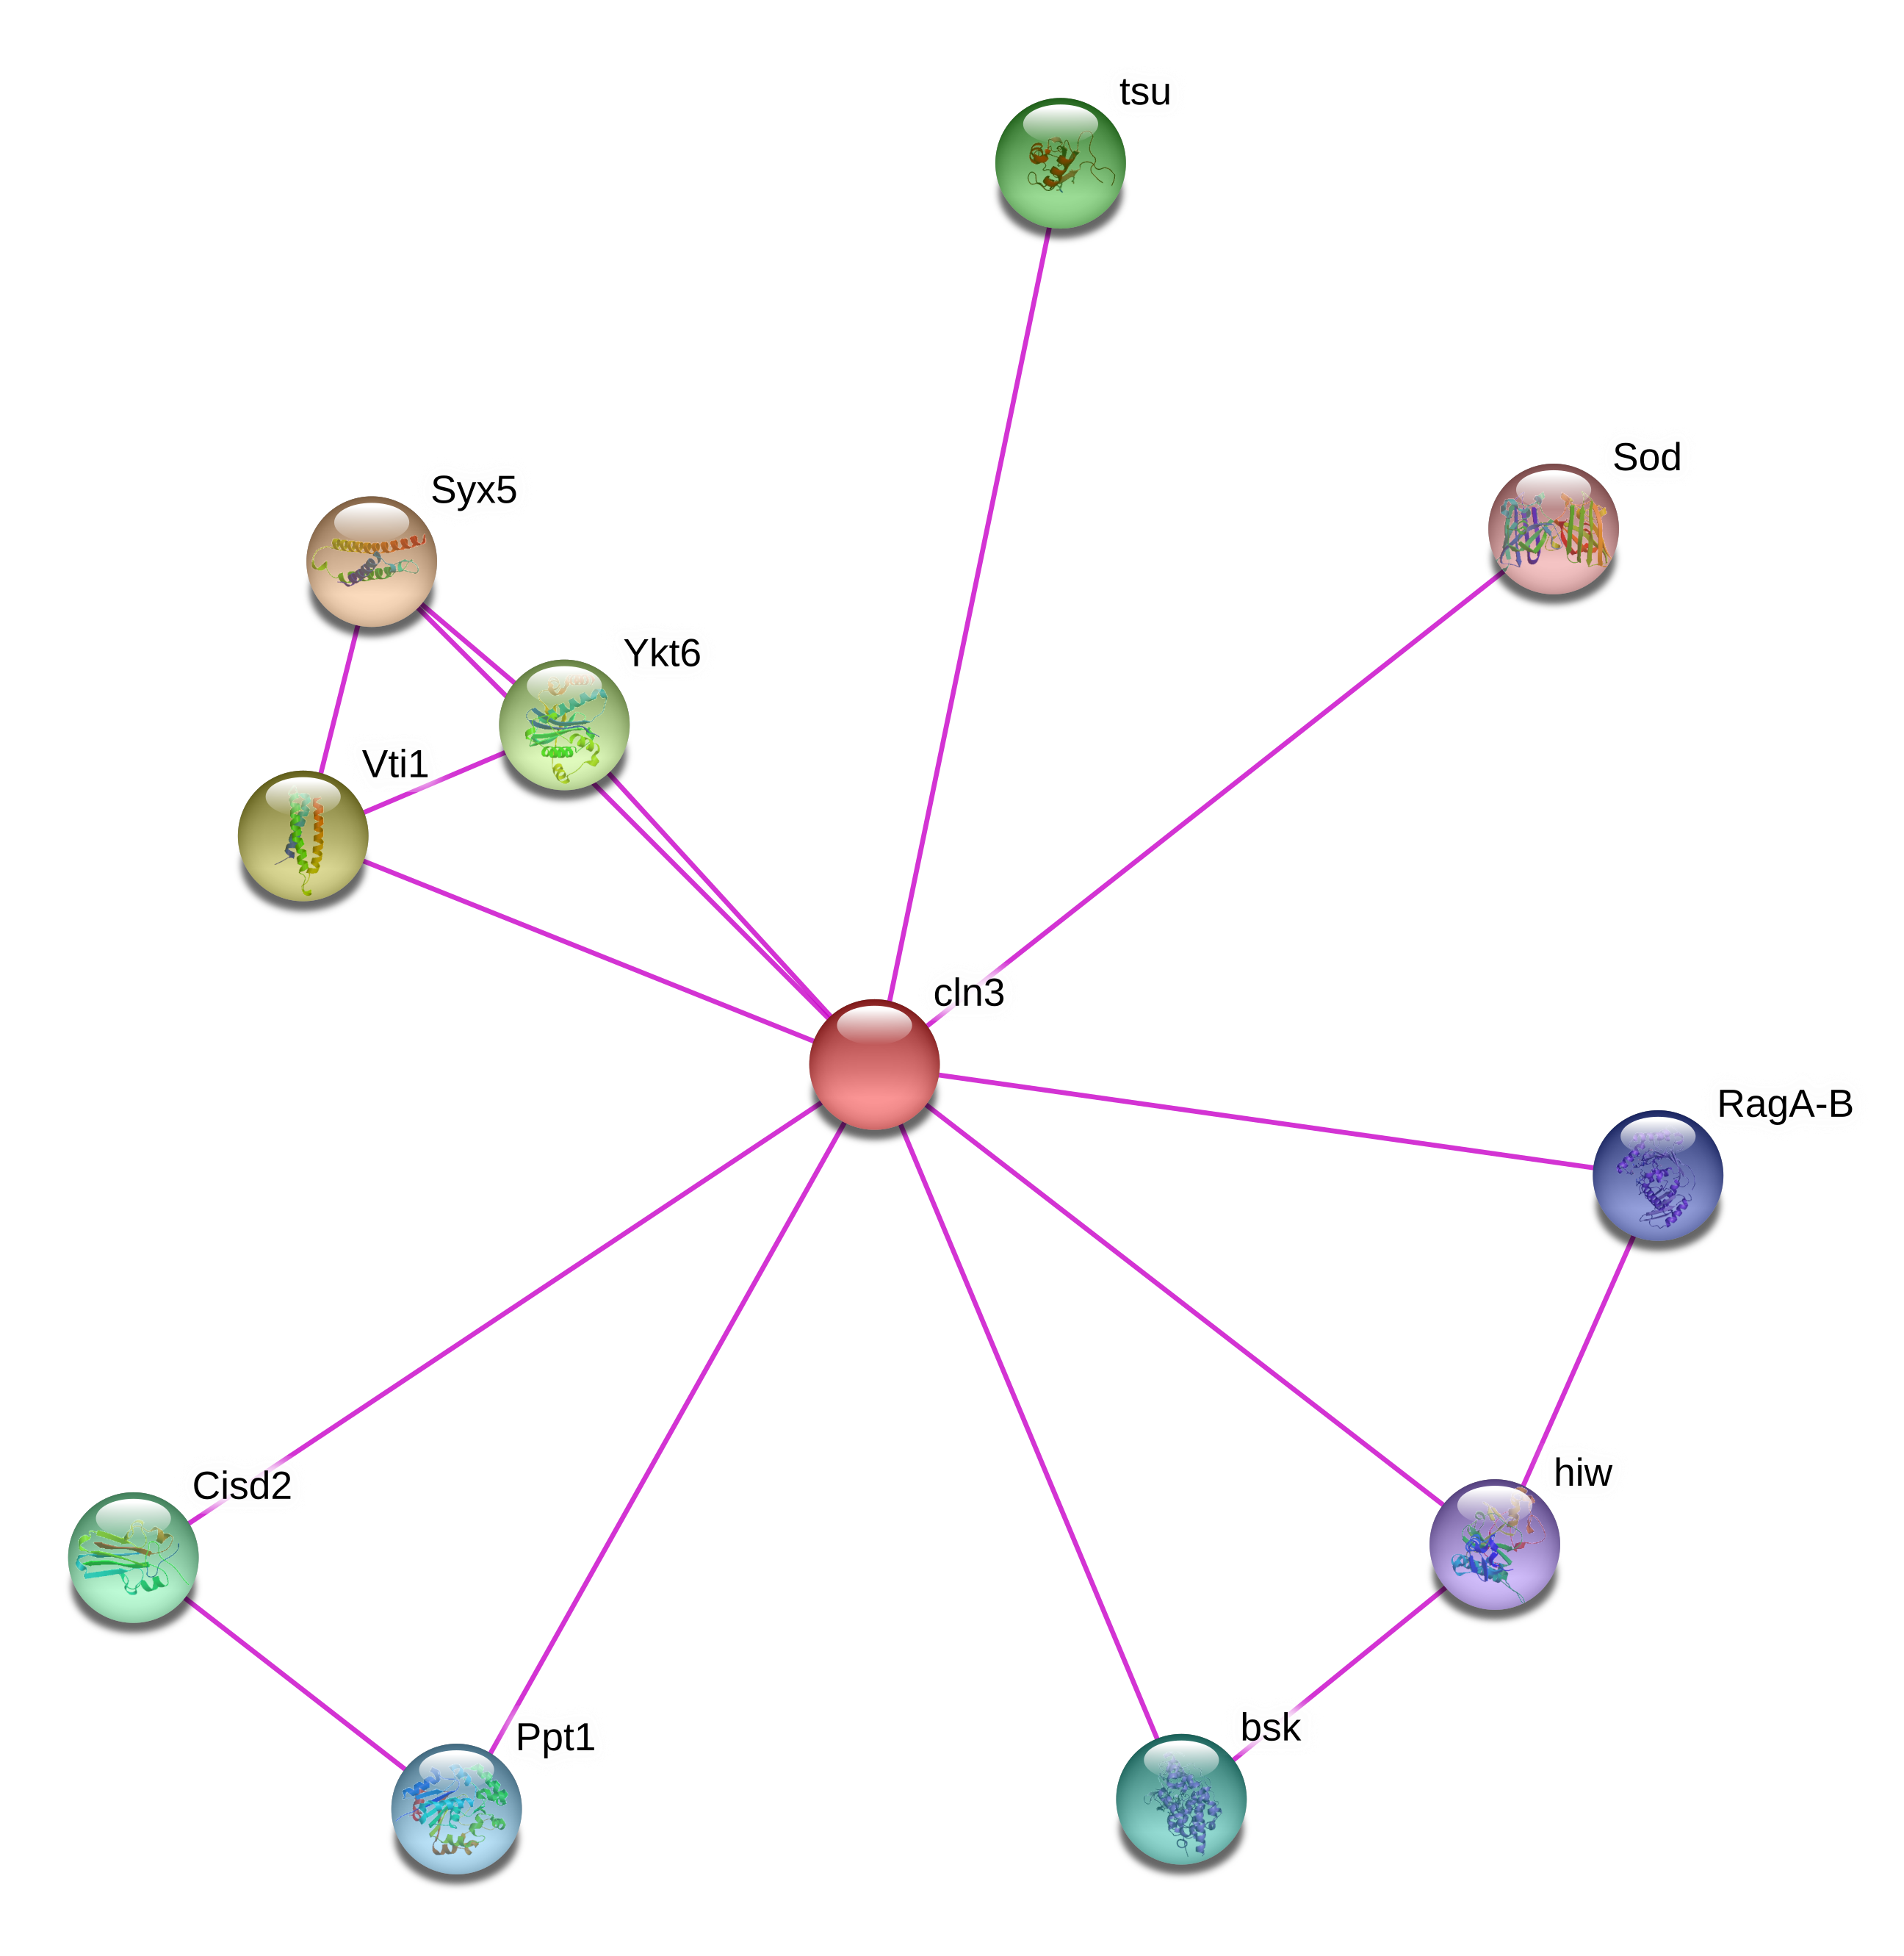
What proteins interact with CLN3?
Human
Fruit Fly
RNA binding
RNA binding

Slide 11
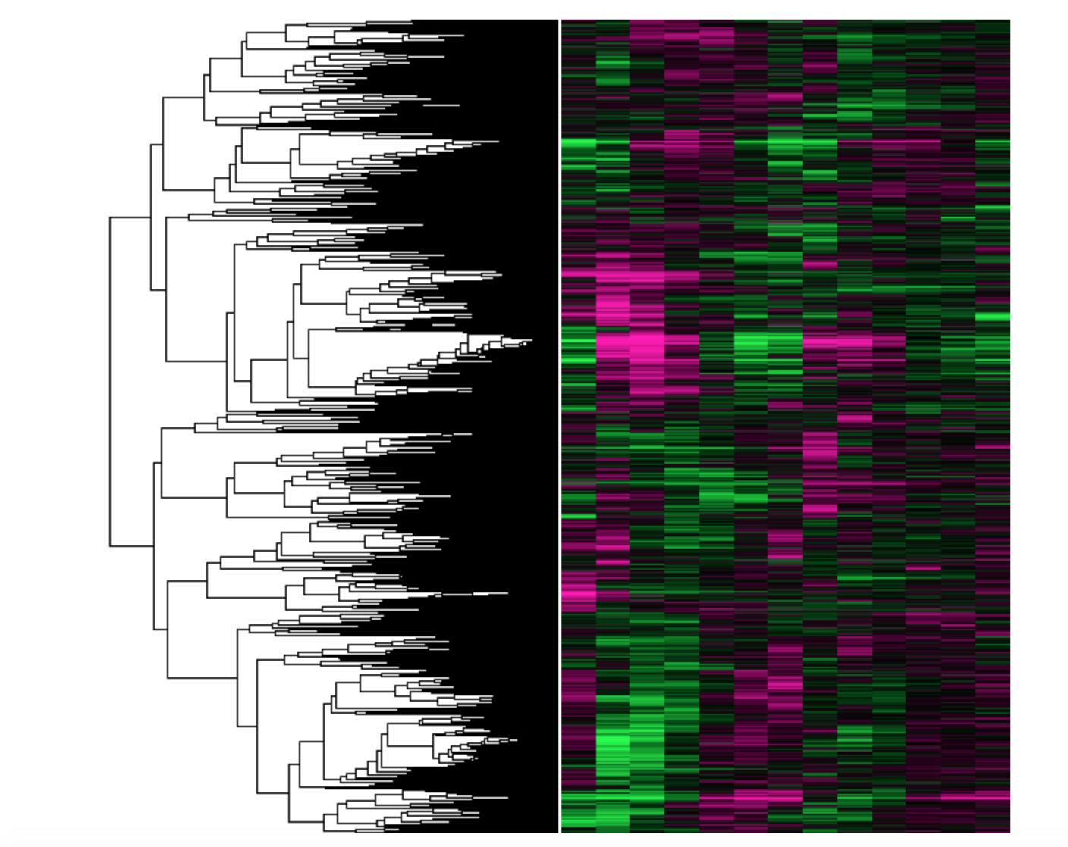
What is the primary goal?
To better understand the role of CLN3 on the neuronal lysosome, and how a mutation in this gene causes Batten Disease.
Aim 1
Aim 2
Aim 3
Characterize conserved amino acids of CLN3 to identify a potential protein function
Characterize the role of CLN3 in vision loss from Batten Disease
Identify and mutate phosphorylation sites in CLN3 that are important for eye function

Slide 12
Aim 1: Characterize conserved amino acids of CLN3 to identify a potential protein function.
Find Homology
CRISPR/Cas9
Screen for Mutants

Slide 13
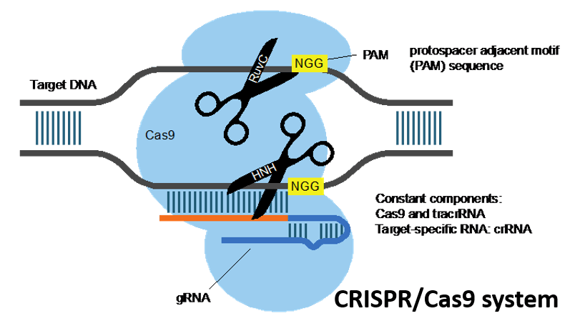
Aim 1: Characterize conserved amino acids of CLN3 to identify a potential protein function.
Find Homology
CRISPR/Cas9
Screen for Mutants
Target DNA

Slide 14
Aim 1: Characterize conserved amino acids of CLN3 to identify a potential protein function.
Find Homology
CRISPR/Cas9
Screen for Mutants
No effect
Desired result
Wild Type
Hypothesis: Specific amino acids in conserved CLN3 will correlate with the eye phenotype in Batten Disease.

Slide 15
Aim 2: Characterize the role of CLN3 in vision loss from Batten Disease
RNA Sequencing
Gene Ontology
Pathway Analysis

Slide 16
Aim 2: Characterize the role of CLN3 in vision loss from Batten Disease
RNA Sequencing
Gene Ontology
Pathway Analysis
Wild Type
Mutant

Slide 17
Aim 2: Characterize the role of CLN3 in vision loss from Batten Disease
RNA Sequencing
Gene Ontology
Pathway Analysis
Hypothesis: Mutants with vision loss will have different expression profiles from the wild type, and will give insight to what pathway CLN3 is connected to

Slide 18
Aim 3: Identify and mutate phosphorylation sites in CLN3 that are important for eye function
Protein Interactions
NetPhos
Screen for Mutants
RNA binding

Slide 19
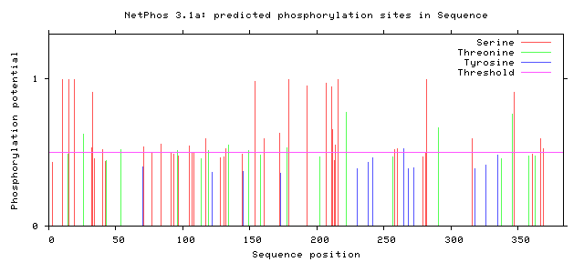
Aim 3: Identify and mutate phosphorylation sites in CLN3 that are important for eye function
Protein Interactions
NetPhos
Screen for Mutants
CKI phosphorylates CLN3

Slide 20
Aim 3: Identify and mutate phosphorylation sites in CLN3 that are important for eye function
Protein Interactions
NetPhos
Screen for Mutants
Mutated
Wild type
Hypothesis: Mutating some of the most conserved phosphorylation sites will decrease the prevalence of vision loss in Batten Disease

Slide 21
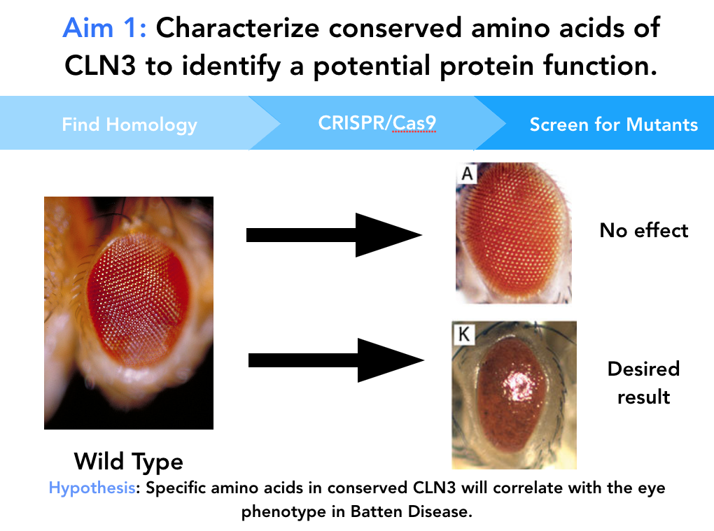
Conclusion
Specific conserved amino acids in CLN3 correlate with
Expression of CLN3, and other correlating proteins are different in wild type versus mutant
Phosphorylation of specific amino acids leads to vision loss

Slide 22
Future Directions

Slide 23
References
Mathavarajah, S., Mclaren, M. D., & Huber, R. J. (2018). Cln3 function is linked to osmoregulation in a Dictyostelium model of Batten disease. Biochimica Et Biophysica Acta (BBA) - Molecular Basis of Disease,1864(11), 3559-3573. doi:10.1016/j.bbadis.2018.08.013
Somogyi, A., Petcherski, A., Beckert, B., Huebecker, M., Priestman, D., Banning, A., . . . Tikkanen, R. (2018). Altered Expression of Ganglioside Metabolizing Enzymes Results in GM3 Ganglioside Accumulation in Cerebellar Cells of a Mouse Model of Juvenile Neuronal Ceroid Lipofuscinosis. International Journal of Molecular Sciences,19(2), 625. doi:10.3390/ijms19020625
Boswell-Casteel, R. C., & Hays, F. A. (2016). Equilibrative nucleoside transporters-A review. Nucleosides, nucleotides & nucleic acids, 36(1), 7-30.
Perland, E., Bagchi, S., Klaesson, A., & Fredriksson, R. (2017). Characteristics of 29 novel atypical solute carriers of major facilitator superfamily type: evolutionary conservation, predicted structure and neuronal co-expression. Open biology, 7(9), 170142.
Schultz, M. L., Tecedor, L., Lysenko, E., Ramachandran, S., Stein, C. S., & Davidson, B. L. (2018). Modulating membrane fluidity corrects Batten disease phenotypes in vitro and in vivo. Neurobiology of disease, 115, 182-193.
Images:
https://www.verywellhealth.com/myotonic-muscular-dystrophy-symptoms-4570998
https://www.ninds.nih.gov/Disorders/Patient-Caregiver-Education/Fact-Sheets/Batten-Disease-Fact-Sheet
https://www.researchgate.net/figure/RNA-seq-data-analysis-of-BMs-AMs-and-TMs-A-Heatmap-of-hierarchical-clustering_fig1_321441357
http://geneontology.org/
https://www.researchgate.net/figure/Effect-of-cisd2-Ppt1-and-cln3-on-external-eye-morphology-Light-microscopic-images-A-K_fig10_261408029
https://www.studyread.com/importance-of-lysosomes/
https://www.sciencedirect.com/science/article/pii/S0167488907000705
https://www.ncbi.nlm.nih.gov/pmc/articles/PMC4201705/
https://www.ncbi.nlm.nih.gov/pmc/articles/PMC5484617/

